Slide 1


Understanding Text Structure
www.floridaipdae.org
©2015 IPDAE. All rights reserved. All content in this presentation is the proprietary property of The Institute for the Professional Development of Adult Educators

Slide 2

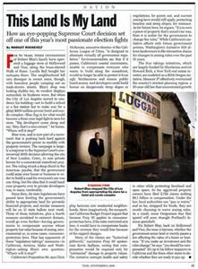
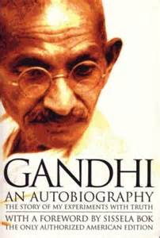
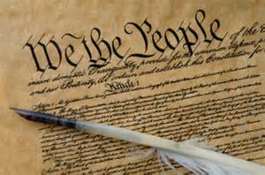
What is text structure?
Writers use different structures to build their ideas.
Each text structure communicates ideas in a different way.
2
©2015 IPDAE. All rights reserved. All content in this presentation is the proprietary property of The Institute for the Professional Development of Adult Educators

Slide 3
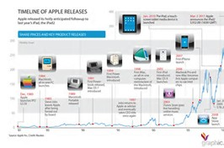
Chronological Order
Authors use chronological order to explain how things happen in order.
Chronological order is also called sequence or time order.
3
©2015 IPDAE. All rights reserved. All content in this presentation is the proprietary property of The Institute for the Professional Development of Adult Educators

Slide 4

Chronological Order
You will know that you are reading a text in chronological order because you will see signal words like first, next, later, then, and finally.
4
©2015 IPDAE. All rights reserved. All content in this presentation is the proprietary property of The Institute for the Professional Development of Adult Educators

Slide 5
Chronological Order
You will often see chronological order in directions:
Have you ever made macaroni and cheese? It’s simple! First, boil some water and make some macaroni. Then, make your cheese sauce. After the cheese sauce is ready, mix it with the macaroni. Bake the entire thing in the oven. Finally, it’s time to eat!
5
©2015 IPDAE. All rights reserved. All content in this presentation is the proprietary property of The Institute for the Professional Development of Adult Educators

Slide 6
Chronological Order
Which paragraph is in chronological order?
Pennsylvania has many historic sites. You can visit Revolutionary war sites, like Valley Forge. You can also visit important locations from the Civil War, like Gettysburg. Finally, you can also see the site of the first oil well in Titusville. Pennsylvania has many neat places to visit!
Through the ages, Pennsylvania has seen many interesting events. The state was founded in 1681 by William Penn. Later, Pennsylvania was the site of important Revolutionary War battles. After that, Pennsylvania was home to new factories during the Industrial Revolution. Today, Pennsylvania continues to make history.
6
©2015 IPDAE. All rights reserved. All content in this presentation is the proprietary property of The Institute for the Professional Development of Adult Educators

Slide 7
Chronological Order
Which paragraph is in chronological order?
This is the paragraph in chronological order. Can you find the clue or signal words that show this order?
Through the ages, Pennsylvania has seen many interesting events. The state was founded in 1681 by William Penn. Later, Pennsylvania was the site of important Revolutionary War battles. After that, Pennsylvania was home to new factories during the Industrial Revolution. Today, Pennsylvania continues to make history.
7
©2015 IPDAE. All rights reserved. All content in this presentation is the proprietary property of The Institute for the Professional Development of Adult Educators

Slide 8
Chronological Order
Which paragraph is in chronological order?
This is the paragraph in chronological order. Can you find the clue or signal words that show this order?
Through the ages, Pennsylvania has seen many interesting events. The state was founded in 1681 by William Penn. Later, Pennsylvania was the site of important Revolutionary War battles. After that, Pennsylvania was home to new factories during the Industrial Revolution. Today, Pennsylvania continues to make history.
8
©2015 IPDAE. All rights reserved. All content in this presentation is the proprietary property of The Institute for the Professional Development of Adult Educators

Slide 9

A Quick Review
Think about it!
What is a text structure?
What does chronological order mean?
What are some signal or clue words that show chronological order?
Discuss and share your responses with a partner.
9
©2015 IPDAE. All rights reserved. All content in this presentation is the proprietary property of The Institute for the Professional Development of Adult Educators

Slide 10

Another text structure
But what if an author doesn’t want to show how something happened in sequence?
The author would need to use another text structure!
10
©2015 IPDAE. All rights reserved. All content in this presentation is the proprietary property of The Institute for the Professional Development of Adult Educators

Slide 11
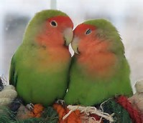
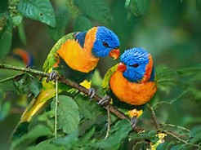
Consider this . . .
Suppose an author wanted to explain how these two birds are similar and different.
Chronological order wouldn’t work---there is no order of events.
The author would need to use compare and contrast.
11
©2015 IPDAE. All rights reserved. All content in this presentation is the proprietary property of The Institute for the Professional Development of Adult Educators

Slide 12
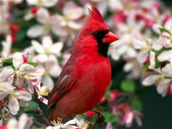
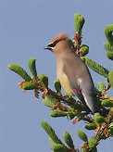
Compare and Contrast
The cardinal and the cedar waxwing are two common birds. Both have crests on their heads. Both are common at birdfeeders. But the birds have some differences. The male cardinal is a bright red, while the waxwing is brown. The cedar waxwing often migrates from place to place. On the other hand, the cardinal stays in one place year after year.
12
©2015 IPDAE. All rights reserved. All content in this presentation is the proprietary property of The Institute for the Professional Development of Adult Educators

Slide 13
Compare and Contrast
When authors use the text structure of compare and contrast, they often use special clue words to show this text structure.
13
©2015 IPDAE. All rights reserved. All content in this presentation is the proprietary property of The Institute for the Professional Development of Adult Educators

Slide 14
Compare and Contrast
Can you find the signal words?
The cardinal and the cedar waxwing are two common birds. Both have crests on their heads. Both are common at birdfeeders. But the birds have some differences. The male cardinal is a bright red, while the waxwing is brown. The cedar waxwing often migrates from place to place. On the other hand, the cardinal stays in one place year after year.
14
©2015 IPDAE. All rights reserved. All content in this presentation is the proprietary property of The Institute for the Professional Development of Adult Educators

Slide 15
Compare and Contrast
What are the signal words?
The cardinal and the cedar waxwing are two common birds. Both have crests on their heads. Both are common at birdfeeders. But the birds have some differences. The male cardinal is a bright red, while the waxwing is brown. The cedar waxwing often migrates from place to place. On the other hand, the cardinal stays in one place year after year.
15
©2015 IPDAE. All rights reserved. All content in this presentation is the proprietary property of The Institute for the Professional Development of Adult Educators

Slide 16
Compare and Contrast Graphic Organizers
To organize details from a paragraph in compare and contrast, use a Venn diagram or graphic organizer.
16
©2015 IPDAE. All rights reserved. All content in this presentation is the proprietary property of The Institute for the Professional Development of Adult Educators

Slide 17

A Quick Review
Think about it!
Can you explain the difference between chronological order and compare and contrast?
How can signal or clue words help you as a reader?
Share and discuss your
responses with a partner.
17
©2015 IPDAE. All rights reserved. All content in this presentation is the proprietary property of The Institute for the Professional Development of Adult Educators

Slide 18

Cause and Effect
Sometimes, a writer will want to explain how one event leads to another.
This kind of text structure is called cause and effect.
18
©2015 IPDAE. All rights reserved. All content in this presentation is the proprietary property of The Institute for the Professional Development of Adult Educators

Slide 19
Cause and Effect
Cause and Effect Signal Words
When authors write paragraphs to show causes and effects, they use words like cause, effect, as a result, consequently, and so.
19
©2015 IPDAE. All rights reserved. All content in this presentation is the proprietary property of The Institute for the Professional Development of Adult Educators

Slide 20
Cause and Effect
Can you find the signal words in the passage?
The night’s snowstorm had many effects. People were out shoveling snow from their sidewalks. The power lines were draped with ice. Snow plows drove down every street. Children were the happiest of all. The unexpected snow caused school to be cancelled!
20
©2015 IPDAE. All rights reserved. All content in this presentation is the proprietary property of The Institute for the Professional Development of Adult Educators

Slide 21
Cause and Effect
What are the signal words?
The night’s snowstorm had many effects. People were out shoveling snow from their sidewalks. The power lines were draped with ice. Snow plows drove down every street. Children were the happiest of all. The unexpected snow caused school to be cancelled!
21
©2015 IPDAE. All rights reserved. All content in this presentation is the proprietary property of The Institute for the Professional Development of Adult Educators

Slide 22
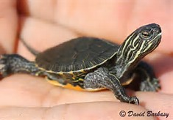
Cause and Effect
More about cause and effect
Young painted turtles spend all winter in their nests. They have special chemicals in their blood that can keep their blood from freezing. As a result, young painted turtles can survive freezing temperatures!
What permits young painted turtles to be able to survive in extreme cold weather?
22
©2015 IPDAE. All rights reserved. All content in this presentation is the proprietary property of The Institute for the Professional Development of Adult Educators

Slide 23
Cause and Effect
More about cause and effect
Young painted turtles spend all winter in their nests. They have special chemicals in their blood that can keep their blood from freezing. As a result, young painted turtles can survive freezing temperatures!
This is the cause
23
©2015 IPDAE. All rights reserved. All content in this presentation is the proprietary property of The Institute for the Professional Development of Adult Educators

Slide 24
Cause and Effect
More about cause and effect
Young painted turtles spend all winter in their nests. They have special chemicals in their blood that can keep their blood from freezing. As a result, young painted turtles can survive freezing temperatures!
This is the effect.
24
©2015 IPDAE. All rights reserved. All content in this presentation is the proprietary property of The Institute for the Professional Development of Adult Educators

Slide 25
A Quick Review
Think about it!
Which text structure lets the reader know about how things are similar and different?
Compare and contrast
Which text structure explains how things happen in time order?
Chronological order
25
©2015 IPDAE. All rights reserved. All content in this presentation is the proprietary property of The Institute for the Professional Development of Adult Educators

Slide 26

Problem and Solution
Sometimes, an author will want to explain a problem, and then show one or more solutions.
This kind of text structure is called problem and solution.
26
©2015 IPDAE. All rights reserved. All content in this presentation is the proprietary property of The Institute for the Professional Development of Adult Educators

Slide 27
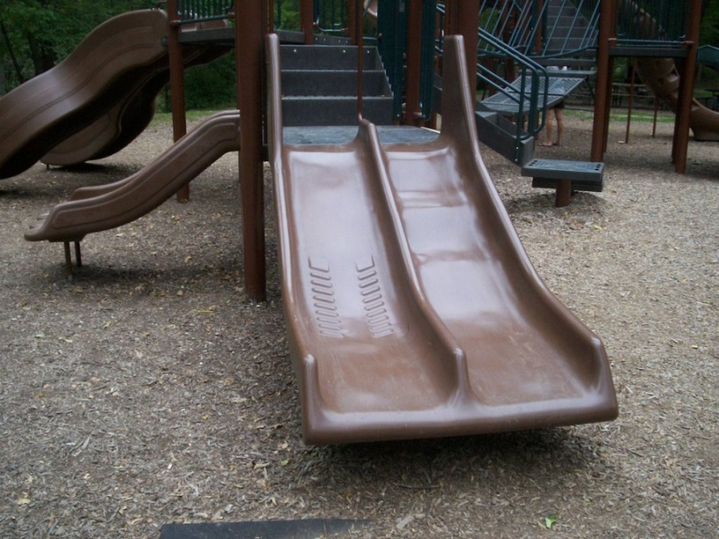
An Example of Problem and Solution
Problem and Solution
Park School had a terrible problem. Every day at recess, students would argue over the slides. Teachers had to spend time every day taking care of the arguments. Finally, one teacher came up with a great solution. They bought another set of slides that everyone could enjoy.
27
©2015 IPDAE. All rights reserved. All content in this presentation is the proprietary property of The Institute for the Professional Development of Adult Educators

Slide 28
Problem and Solution
Park School had a terrible problem. Every day at recess, students would argue over the slides. Teachers had to spend time every day taking care of the arguments. Finally, one teacher came up with a great solution. They bought another set of slides that everyone could enjoy.
Can you identify the problem and the solution in this paragraph?
28
©2015 IPDAE. All rights reserved. All content in this presentation is the proprietary property of The Institute for the Professional Development of Adult Educators

Slide 29
Problem and Solution
Park School had a terrible problem. Every day at recess, students would argue over the slides. Teachers had to spend time every day taking care of the arguments. Finally, one teacher came up with a great solution. They bought another set of slides that everyone could enjoy.
Here is the problem
What is the solution?
29
©2015 IPDAE. All rights reserved. All content in this presentation is the proprietary property of The Institute for the Professional Development of Adult Educators

Slide 30
Problem and Solution
Park School had a terrible problem. Every day at recess, students would argue over the slides. Teachers had to spend time every day taking care of the arguments. Finally, one teacher came up with a great solution. They bought another set of slides that everyone could enjoy.
Here is the problem
Here is the solution.
30
©2015 IPDAE. All rights reserved. All content in this presentation is the proprietary property of The Institute for the Professional Development of Adult Educators

Slide 31
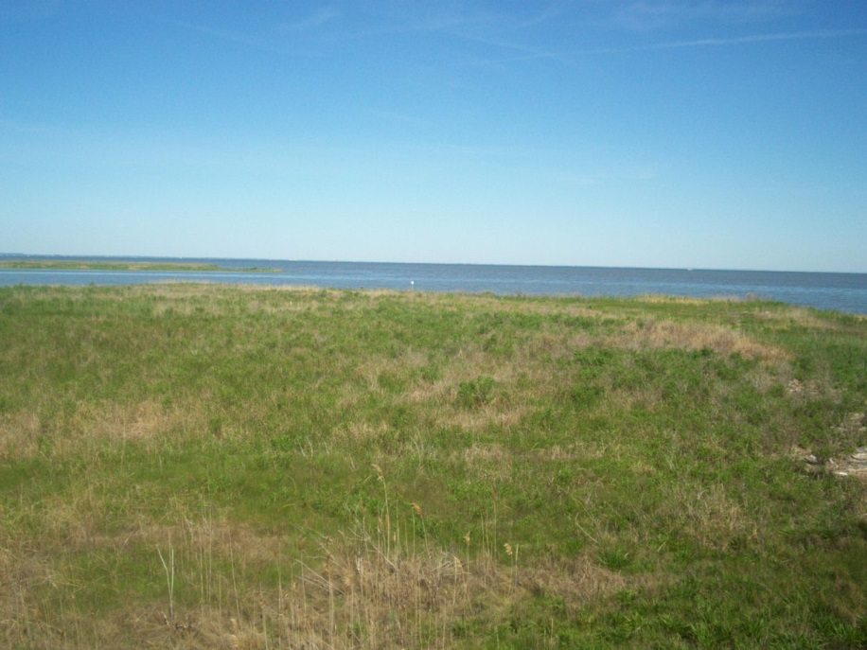
Problem and Solution is not always so simple
Problem and Solution
Often, authors will signal problem and solution structure with signal words like problem and solution, just like in the last paragraph.
Sometimes, authors will use related words.
31
©2015 IPDAE. All rights reserved. All content in this presentation is the proprietary property of The Institute for the Professional Development of Adult Educators

Slide 32
Other clue words for problem and solution
Problem and Solution
Synonyms for problem include difficulty, struggle, uncertainty, worry, threat, and trouble.
Synonyms for solution include possibility, hope, bright spot, answer, and future.
32
©2015 IPDAE. All rights reserved. All content in this presentation is the proprietary property of The Institute for the Professional Development of Adult Educators

Slide 33
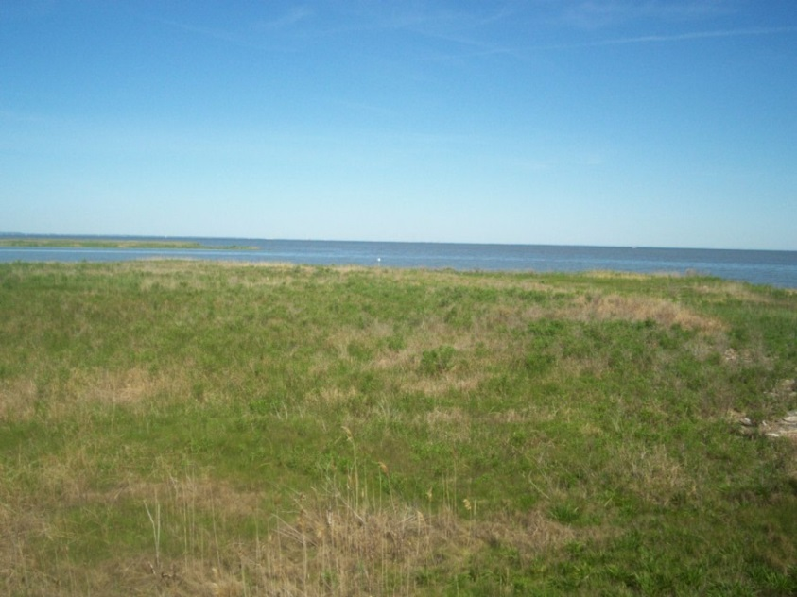
Problem and Solution
The Chesapeake Bay faces an uncertain future. Issues such as pesticides, too many nutrients, and habitat loss all threaten the Bay’s water quality and animal life. However, scientists are hopeful that the future may be brighter. If everyone in the Chesapeake Bay watershed works together, solutions may be found.
33
©2015 IPDAE. All rights reserved. All content in this presentation is the proprietary property of The Institute for the Professional Development of Adult Educators

Slide 34
Problem and Solution
The Chesapeake Bay faces an uncertain future. Issues such as pesticides, too many nutrients, and habitat loss all threaten the Bay’s water quality and animal life. However, scientists are hopeful that the future may be brighter. If everyone in the Chesapeake Bay watershed works together, solutions may be found.
What is the problem?
What is the solution?
34
©2015 IPDAE. All rights reserved. All content in this presentation is the proprietary property of The Institute for the Professional Development of Adult Educators

Slide 35
Problem and Solution
The Chesapeake Bay faces an uncertain future. Issues such as pesticides, too many nutrients, and habitat loss all threaten the Bay’s water quality and animal life. However, scientists are hopeful that the future may be brighter. If everyone in the Chesapeake Bay watershed works together, solutions may be found.
Problem
Solution
35
©2015 IPDAE. All rights reserved. All content in this presentation is the proprietary property of The Institute for the Professional Development of Adult Educators

Slide 36
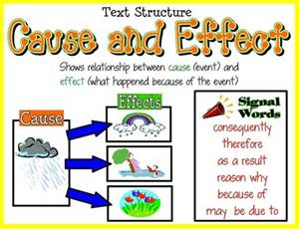
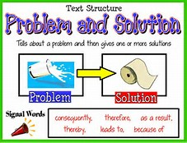
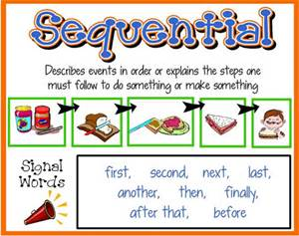
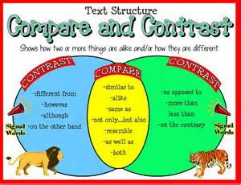
A Quick Review
Chronological Order
Compare and Contrast
Cause and Effect
Problem and Solution
36
©2015 IPDAE. All rights reserved. All content in this presentation is the proprietary property of The Institute for the Professional Development of Adult Educators

Slide 37


Review
Now It’s Your Turn
On the next few slides, you will read some passages about the Great Chicago Fire.
Your task is to decide on the text structure for each one.
Understanding the text structure will help you to understand each passage and the message the author is attempting to convey.
37
©2015 IPDAE. All rights reserved. All content in this presentation is the proprietary property of The Institute for the Professional Development of Adult Educators

Slide 38
Identify the Text Structure in the Passage
A Quick Review
Daniel Sullivan was the first to notice the flames coming from the O’Leary barn at around 8:30 pm on October 8. A problem with the alarm box made it impossible for the people in the area to call for the fire department. By 9:30 pm, the entire block was blazing. In another 3 hours, there were fires all over Chicago. The heavy wind coming from the lake only made the fire bigger. It would be another day before the fire would be completely out. By that time, 17,500 buildings had been burned.
Chronological Order
Compare and Contrast
Cause and Effect
Problem and Solution
38
©2015 IPDAE. All rights reserved. All content in this presentation is the proprietary property of The Institute for the Professional Development of Adult Educators

Slide 39
Identify the Text Structure in the Passage
A Quick Review
Daniel Sullivan was the first to notice the flames coming from the O’Leary barn at around 8:30 pm on October 8. A problem with the alarm box made it impossible for the people in the area to call for the fire department. By 9:30 pm, the entire block was blazing. In another 3 hours, there were fires all over Chicago. The heavy wind coming from the lake only made the fire bigger. It would be another day before the fire would be completely out. By that time, 17,500 buildings had been burned.
Chronological Order
Notice how the paragraph shows how events happen in time order.
39
©2015 IPDAE. All rights reserved. All content in this presentation is the proprietary property of The Institute for the Professional Development of Adult Educators

Slide 40
Identify the Text Structure in the Passage
A Quick Review
Daniel Sullivan was the first to notice the flames coming from the O’Leary barn at around 8:30 pm on October 8. A problem with the alarm box made it impossible for the people in the area to call for the fire department. By 9:30 pm, the entire block was blazing. In another 3 hours, there were fires all over Chicago. The heavy wind coming from the lake only made the fire bigger. It would be another day before the fire would be completely out. By that time, 17,500 buildings had been burned.
Understanding that this text is written in chronological order can help you to understand how the Great Chicago Fire started.
40
©2015 IPDAE. All rights reserved. All content in this presentation is the proprietary property of The Institute for the Professional Development of Adult Educators

Slide 41
Identify the Text Structure in the Passage
A Quick Review
Why was the Great Chicago Fire so disastrous? After all, Chicago had fire departments and fire alarms. One reason for the terrible fire is that the alarm malfunctioned. The local fire company noticed the fire by accident as it was returning from another fire. As another problem, a watchman who saw the flames directed other fire companies to a location that was nearly a mile away from the fire. Because of these two problems, a fire that could have been controlled rapidly spread across the city.
Chronological Order
Compare and Contrast
Cause and Effect
Problem and Solution
41
©2015 IPDAE. All rights reserved. All content in this presentation is the proprietary property of The Institute for the Professional Development of Adult Educators

Slide 42
Identify the Text Structure in the Passage
A Quick Review
Why was the Great Chicago Fire so disastrous? After all, Chicago had fire departments and fire alarms. One reason for the terrible fire is that the alarm malfunctioned. The local fire company noticed the fire by accident as it was returning from another fire. As another problem, a watchman who saw the flames directed other fire companies to a location that was nearly a mile away from the fire. Because of these two problems, a fire that could have been controlled rapidly spread across the city.
Cause and Effect
Notice how the causes (in purple) lead to the effect (in green).
42
©2015 IPDAE. All rights reserved. All content in this presentation is the proprietary property of The Institute for the Professional Development of Adult Educators

Slide 43
Identify the Text Structure in the Passage
A Quick Review
After the fire, thousands of people were left homeless. Many escaped the fire with nothing except the clothes on their backs. Providing all of these people with food, clean water, and shelter was a huge task. Luckily, the city quickly formed a Relief and Aid Society. This group started giving out the food donations that were pouring in from other cities. The society built places for people to live, gathered the tools that people needed to rebuild their houses, and even vaccinated 64,000 people against smallpox.
Chronological Order
Compare and Contrast
Cause and Effect
Problem and Solution
43
©2015 IPDAE. All rights reserved. All content in this presentation is the proprietary property of The Institute for the Professional Development of Adult Educators

Slide 44
Identify the Text Structure in the Passage
A Quick Review
After the fire, thousands of people were left homeless. Many escaped the fire with nothing except the clothes on their backs. Providing all of these people with food, clean water, and shelter was a huge task. Luckily, the city quickly formed a Relief and Aid Society. This group started giving out the food donations that were pouring in from other cities. The society built places for people to live, gathered the tools that people needed to rebuild their houses, and even vaccinated 64,000 people against smallpox.
Problem and Solution
Here is the problem.
44
©2015 IPDAE. All rights reserved. All content in this presentation is the proprietary property of The Institute for the Professional Development of Adult Educators

Slide 45
Identify the Text Structure in the Passage
A Quick Review
After the fire, thousands of people were left homeless. Many escaped the fire with nothing except the clothes on their backs. Providing all of these people with food, clean water, and shelter was a huge task. Luckily, the city quickly formed a Relief and Aid Society. This group started giving out the food donations that were pouring in from other cities. The society built places for people to live, gathered the tools that people needed to rebuild their houses, and even vaccinated 64,000 people against smallpox.
Problem and Solution
Here is the problem.
Here is the solution.
45
©2015 IPDAE. All rights reserved. All content in this presentation is the proprietary property of The Institute for the Professional Development of Adult Educators

Slide 46
Identify the Text Structure in the Passage
A Quick Review
Chicago changed in many ways after the fire. Before the fire, most of the buildings were less than five stories high. The buildings that were constructed after the fire, however, were some of the first skyscrapers in the country. Before the fire, most of the houses were made of wood. After the fire, people chose to build their houses out of stone or brick. There were changes in where people lived, as well. The poor people in the city lived close to the center of the city before the fire. After the fire, they moved into neighborhoods that were farther away from the downtown area.
Chronological Order
Compare and Contrast
Cause and Effect
Problem and Solution
46
©2015 IPDAE. All rights reserved. All content in this presentation is the proprietary property of The Institute for the Professional Development of Adult Educators

Slide 47
Identify the Text Structure in the Passage
A Quick Review
Chicago changed in many ways after the fire. Before the fire, most of the buildings were less than five stories high. The buildings that were constructed after the fire, however, were some of the first skyscrapers in the country. Before the fire, most of the houses were made of wood. After the fire, people chose to build their houses out of stone or brick. There were changes in where people lived, as well. The poor people in the city lived close to the center of the city before the fire. After the fire, they moved into neighborhoods that were farther away from the downtown area.
Compare and Contrast
Notice how the paragraph is comparing Chicago BEFORE the fire to Chicago AFTER the fire.
47
©2015 IPDAE. All rights reserved. All content in this presentation is the proprietary property of The Institute for the Professional Development of Adult Educators

Slide 48
Reflection
According to the passages that were reviewed today, how can understanding text structure assist a reader when they read?
What role do signal or clue words play in assisting the reader in understanding the organization of informational text?
Share your response with a partner.
48
©2015 IPDAE. All rights reserved. All content in this presentation is the proprietary property of The Institute for the Professional Development of Adult Educators

