Slide 1
Using Clues To Determine the Meaning of Multiple Meaning Words
www.floridaipdae.org
©2015 IPDAE. All rights reserved. All content in this presentation is the proprietary property of The Institute for the Professional Development of Adult Educators

Slide 2
Defining multiple meaning words
Since some words have more than one meaning, you have to consider which meaning the author intends.
Keep in mind the context in which you read the word.
The context will tell you which meaning to choose.
©2015 IPDAE. All rights reserved. All content in this presentation is the proprietary property of The Institute for the Professional Development of Adult Educators
Notes:
2

Slide 3
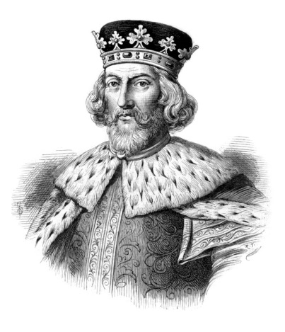
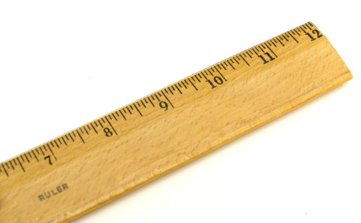
Defining multiple meaning words
What makes corny jokes corny?
Why did the king always draw straight lines?
He was the ruler!
What makes this joke funny?
©2015 IPDAE. All rights reserved. All content in this presentation is the proprietary property of The Institute for the Professional Development of Adult Educators
Notes:
3

Slide 4
Defining multiple meaning words
Yes, you giggled because the joke has a word with multiple meanings (ruler).
The joke plays off the meaning of both words.
When an author uses words with multiple meanings, readers have to figure out which meaning of the word is intended.
©2015 IPDAE. All rights reserved. All content in this presentation is the proprietary property of The Institute for the Professional Development of Adult Educators
Notes:
4

Slide 5
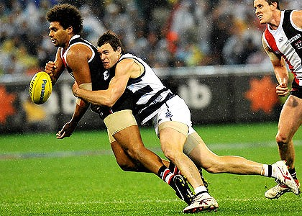
Clues to multiple meaning words
Using Context Clues:
To tackle the difficult problem of learning words that have multiple meanings, try a variety of methods until you find what works for you.
©2015 IPDAE. All rights reserved. All content in this presentation is the proprietary property of The Institute for the Professional Development of Adult Educators
Notes:
5

Slide 6
Clues to multiple meaning words
Learn the Most Common Meaning:
Learn the most common meaning of a word.
Although many words have multiple meanings, the most common meaning is often used much more frequently than the others.
Dictionaries list entries in order from the most common to least common.
©2015 IPDAE. All rights reserved. All content in this presentation is the proprietary property of The Institute for the Professional Development of Adult Educators
Notes:
6

Slide 7
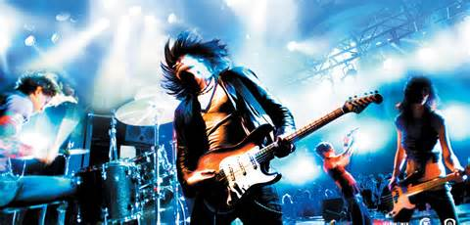
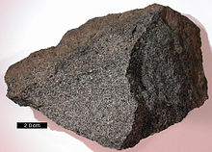
Clues to multiple meaning words
Parts of Speech Provide Clues to Multiple Meanings:
ROCK (Noun): A type of sedimentary rock is called limestone.
ROCK (Adjective): My brother has tickets to see his favorite rock band in concert.
ROCK (Verb): The news of the earthquake in Japan will rock the global community.
©2015 IPDAE. All rights reserved. All content in this presentation is the proprietary property of The Institute for the Professional Development of Adult Educators
Notes:
7

Slide 8
Clues to multiple meaning words
How Can I Remember Multiple Meanings?
Write short and simple example sentences that will help you remember the meaning of the word.
Illustrate the meaning of multiple meaning words.
Use a Frayer Model.
ROCK (Adjective): My brother has tickets to see his favorite rock band in concert.
ROCK (Noun): A type of sedimentary rock is called limestone.
rock
ROCK (Verb): The news of the earthquake in Japan will rock the global community.
ROCK (Verb): When the baby cries, be sure to rock him in the rocking chair.
©2015 IPDAE. All rights reserved. All content in this presentation is the proprietary property of The Institute for the Professional Development of Adult Educators
Notes:
8

Slide 9
Clues to multiple meaning words
Using Synonym Context Clues: Substitute a Synonym for the Unknown Word
Look at the example below. The word “race” could be replaced with the synonyms “competition” or “ethnic group”, depending on the intended meaning.
When you encounter a word with multiple meanings and you are unsure which meaning is correct, replace the word in question with a synonym you have learned.
If the sentence still makes sense, then you will know which definition is being used.
Steve Johnson won several medals in the relay __ at the Ohio State Fair.
Mr. Jackson’s job is to discuss __ and ethnicity found in the United States Census Report.
Notes:
9

Slide 10
Clues to multiple meaning words
Symbolism as a Context Clue:
Look for symbolism if the concrete definition of the word does not make sense in context.
Imagine what the object (head) looks like and what it does.
The word "head" has several symbolic meanings that have to do with being first, leading or going forward because the head is at the top of the body and houses the brain.
A symbolic meaning of "head" is "leader" as in the phrase, "the head of the committee."
©2015 IPDAE. All rights reserved. All content in this presentation is the proprietary property of The Institute for the Professional Development of Adult Educators
Notes:
10

Slide 11
Clues to multiple meaning words
Homophones as Clues to Word Meaning:
The spelling of a word can give you the correct
meaning of a word.
Beth cried as she remembered her painful past.
John was thrilled to learn that he had passed the examination.
There is no place like home.
They’re selling their home in Miami and moving to New York.
©2015 IPDAE. All rights reserved. All content in this presentation is the proprietary property of The Institute for the Professional Development of Adult Educators
Notes:
11

Slide 12
Clues to multiple meaning words
Homographs as Clues to Word Meaning:
Use context clues to figure out the correct pronunciation and meaning of the word.
The child was so afraid of the barking dog, that a tear began to roll down her cheek.
After the football game, John discovered a tear in his football uniform.
©2015 IPDAE. All rights reserved. All content in this presentation is the proprietary property of The Institute for the Professional Development of Adult Educators
Notes:
12

Slide 13
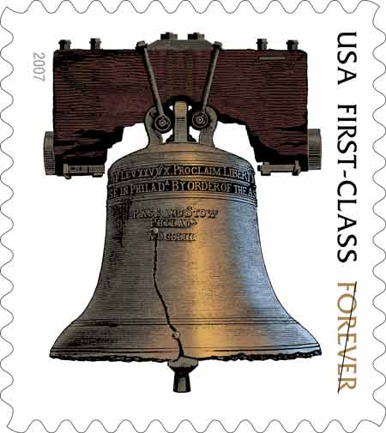
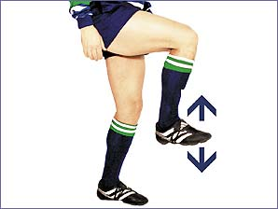
Discussing multiple meaning words
Identify and Discuss Multiple Meanings:
I bought a stamp at the post office.
They always stamp their feet at the pep rally.
The officer had to stamp my passport
©2015 IPDAE. All rights reserved. All content in this presentation is the proprietary property of The Institute for the Professional Development of Adult Educators
Notes:
13

Slide 14
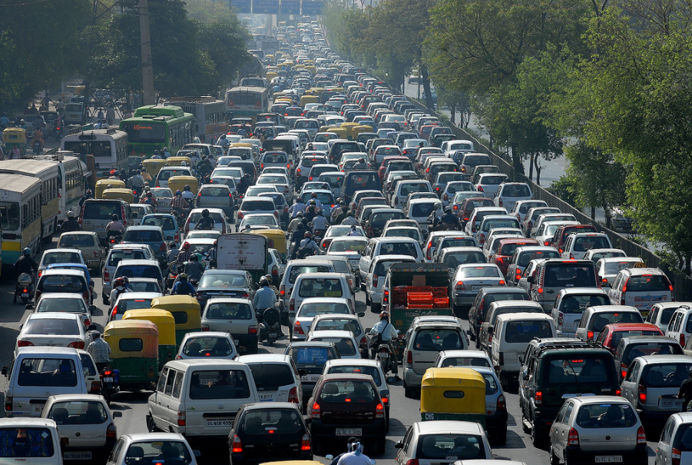
Discussing multiple meaning words
Identify and Discuss Multiple Meanings:
The volume on the radio was too loud.
There was a high volume of traffic on the interstate.
©2015 IPDAE. All rights reserved. All content in this presentation is the proprietary property of The Institute for the Professional Development of Adult Educators
Notes:
14

Slide 15
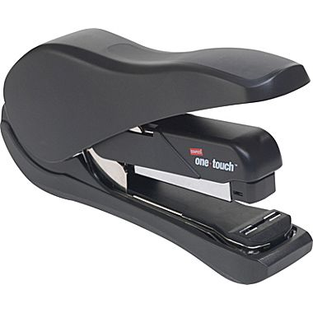
Discussing multiple meaning words
Identify and Discuss Multiple Meanings:
Fresh produce is an
important dietary
staple in many countries.
Our instructions were to produce a book report and staple the finished pages together.
©2015 IPDAE. All rights reserved. All content in this presentation is the proprietary property of The Institute for the Professional Development of Adult Educators
Notes:
15

Slide 16
Applying what you learned
Assessment: Read the excerpt below. In which sentence does execution have the same meaning as used in the excerpt below?
I showed him how to keep his fly from dragging, how to fish the deeper pools. He was absorbed by the whys and hows and the execution.
After an execution of this computer program, the entire system might shut down.
Their plan was sound, but its faulty execution caused a delay in starting the project.
After agreeing on the terms of the sale, the execution of the deed to the house will be finalized.
The execution of the terms of his final will and testament should occur as soon as the judge approves it.
©2015 IPDAE. All rights reserved. All content in this presentation is the proprietary property of The Institute for the Professional Development of Adult Educators
Notes:
16

Slide 17
Applying what you learned
Assessment: Read the lines below. In the lines below, what does the word inclined reveal about the leaf?
The leaf’s inclined to find its own direction; give it a chance to seek the sunlight for itself.
The leaf grows at an angle to find its own direction.
The leaf bends down to find its own direction.
The leaf hesitates to find its own direction.
The leaf prefers to find its own direction.
©2015 IPDAE. All rights reserved. All content in this presentation is the proprietary property of The Institute for the Professional Development of Adult Educators
Notes:
17

Slide 18
Thank You
By Educators For Educators
www.floridaipdae.org
Thank You!
©2015 IPDAE. All rights reserved. All content in this presentation is the proprietary property of The Institute for the Professional Development of Adult Educators
Notes:
18

