Slide 1
INSTITUTE FOR THE PROFESSIONAL
DEVELOPMENT OF ADULT EDUCATORS
Getting to the Core: Florida ELA College and Career Readiness Standards Institute
Workshop Revised 2018
www.floridaipdae.org
This training event is supported with federal funds as appropriated to the Florida Department of Education, Division of Career and Adult Education for the provision of state leadership professional development activities.
Notes:
Key Points
Set the stage for presentation.

Slide 2
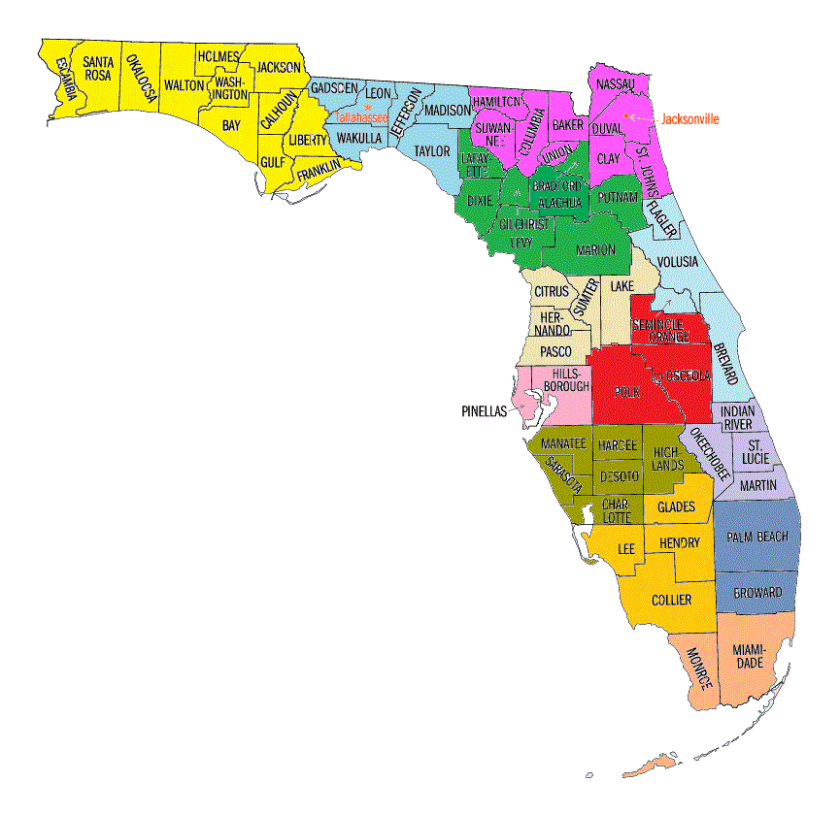
Welcome!
2018 The Institute for the Professional Development of Adult Educators
Notes:
Key Points
Introduce self and provide basic background about yourself.

Slide 3
Objectives of Workshop
Determine key points of a standards-based education
Interpret ELA standards and key shifts
Discuss how to evaluate success by checking against clear milestones
Prepare information and resources with the local program team
3
2018 The Institute for the Professional Development of Adult Educators
Notes:
Key Points
Review the objectives of the session. Share that this workshop will include time for planning and sharing, as the best strategies are those provided through the “wisdom of the crowd.” Include logistical information (lunch, breaks, restrooms, etc.). Thank the host/hostess for providing location for workshop.
Objectives are to:
Determine key points of a standards-based education
Interpret ELA standards and key shifts
Discuss how to evaluate success by checking against clear milestones
Prepare information and resources with the local program team

Slide 4
It’s All About the Learner
The Ideal Graduate
4
2018 The Institute for the Professional Development of Adult Educators
Notes:
Key Points
Provide a short activity to get to know participants. One warm up activity is to have participants form their vision of the ideal adult education graduate and the academic skills and knowledge that the graduate would have.
Participants should introduce themselves, share their vision, and identify one academic skill/knowledge that they know they currently provide in their program. You may wish to jot down some of their ideas to use throughout the training as you discuss shifts and standards.
Sample Script for Activity (You may wish to play Pomp and Circumstance while you’re talking.)
Imagine that you are at your graduation ceremony this spring. You see the graduates excitedly putting on their robes. Your students walk into the auditorium single file, one by one. They are so excited and thrilled that a high school diploma is finally a dream come true.
You have played a major role in these students’ education and have facilitated their accomplishments. As the students cross the stage, you notice one particular student that you remember well. You realize that this student’s academic knowledge will be the pathway that leads him/her on the next journey.
1. What academic knowledge and skills are you hoping this student possesses? (Have participants jot down their ideas. You may wish to have participants use post it notes – one post it note per thought. Provide them with a short time and then continue.)
Three years have now passed since that graduation day and you meet up with this student. What do you hope to see and hear from this person when you ask him/her what were the most important things they learned in your program.
2. Participants should jot their ideas on post it notes (again, one post it note per thought).
Collaboratively, have table groups discuss their thoughts and identify similar and diverse ideas.
Have participants introduce themselves to the group and share one important thing they learned from the activity.

Slide 5
Because we believe in adult learners . . .
“The adult education system cannot stand still while the world around us is changing.”
Cheryl Keenan, Director of Adult Education and Literacy, OVAE: NCFL 2013
2018 The Institute for the Professional Development of Adult Educators
Notes:
Key Points
As Cheryl Keenan states, adult education is changing and with that change comes a major shift in our state’s curriculum frameworks. The purpose of this institute is to become key instructional leaders in our state’s curriculum reform. A reform that begins with the lowest level of literacy through our ASE programs.
It’s a “big” job for all of us. There will definitely be challenges, but there will also be answers as we move forward to ensure that each of our students receives the best possible education in our programs.
Make sure that participants are aware of the acronym PLC (Professional Learning Community) and an overview of its importance in building capacity.

Slide 6
The Challenge
“The key to a successful curriculum reform is to develop a new culture of teaching and learning that can bring about real changes in school life.”
Education Commission (2000)
2018 The Institute for the Professional Development of Adult Educators
Notes:
Key Points
As we begin the discussion today of what is needed to initiate the process of implementing our state’s college and career readiness standards, let’s look a two quotes that identify the “challenge” and the “answer.”

Slide 7
The Answer
“The most promising strategy for sustained, substantive school improvement is developing the ability of school personnel to function as professional learning communities.”
Dufour and Eaker (1998; 2010)
2018 The Institute for the Professional Development of Adult Educators
Notes:
Key Points
Dufour and Eaker advocated professional learning communities in their research in 1998 and again in 2010. Research strongly supports that change occurs when everyone feels a part of the process. The building of professional learning communities at the state, regional, and local levels will be a necessity in order to effective make the changes necessary for success in integrating a standards-based educational system into all of our adult education programs.
To function effectively as a professional learning community requires leadership – the type of leadership that we have in this room.
You may wish to share with participants that materials on developing a professional learning community are part of the resources available to them on the Florida IPDAE website.

Slide 8
The “Big” Picture
Introduction to Standards-Based Education
8
2018 The Institute for the Professional Development of Adult Educators
Notes:
Key Points
Before we dig into the ELA standards for our ABE programs, let’s look at the “Big” Picture of standards-based education.

Slide 9
The Focus
Instructional Quality Student Success
9
2018 The Institute for the Professional Development of Adult Educators
Notes:
Key Points
As we work together, the objective for our working session is that instructional quality equals student success. It is all about the student – something we need to always keep in mind.

Slide 10
What is Required?
“To become college and career ready, students need to grapple with works of exceptional craft and thought whose range extends across genres, cultures, and centuries. By engaging with increasingly complex readings, students gain the ability to evaluate intricate arguments and the capacity to surmount the challenges posed by complex texts.”
10
2018 The Institute for the Professional Development of Adult Educators
Notes:
10
Key Points
Review the quote from the College and Career Readiness Standards for Adult Education regarding the move towards a more rigorous content and how the standards came to be.

Slide 11
What are the Challenges?
Content must be
more rigorous
more closely tied to real-life needs
presented in a continuum, so there is not a separate content for ABE vs. GED® preparation students
11
2018 The Institute for the Professional Development of Adult Educators
Notes:
11
Key Points
Reinforce that there is a real need for curriculum change in our ABE programs and that although it may be difficult at first, the more rigorous, real-world standards will assist our students in becoming more prepared for postsecondary education and the workplace.

Slide 12
What are the Opportunities?
Programs have the opportunity to
Move past teaching to a test
Use a more conceptual approach to learning
Meet the long-term, not just short-term needs of students
Show students the relevance of what they are learning; thus enhancing student motivation and outcomes
12
2018 The Institute for the Professional Development of Adult Educators
Notes:
12
Key Points
It’s not just about challenges; it’s also about the opportunities that moving towards college and career readiness standards provide the adult education programs.

Slide 13
The Big Picture
Programs must
Students must
Rethink content
Rethink instructional practices and materials
Rethink process
Rethink programmatic structure
Read more rigorous text;
Produce evidence-based writing; and
Achieve higher-order mathematical problem-solving skills
13
2018 The Institute for the Professional Development of Adult Educators
Notes:
13
Key Points
Discuss the big picture for programs and for students, including changes in not only content, but also how adult education programs look.

Slide 14
It’s All About the Learner
GUIDING QUESTIONS
Do you believe your students are academically/workplace ready upon completing your ABE Program?
Are they able to communicate effectively both orally and in writing?
Are they marketable?
What has worked? What has not worked?
14
Workbook p. 2
Notes:
Key Points
Let’s take a few minutes and ponder these questions.

Slide 15
It’s All About the Learner
How does your program create a shared vision for academic success?
Is your vision learner oriented?
How could you use this activity to create a shared vision of what you want to achieve as a campus/department?
15
Notes:
Key Points
Let’s think about a few more questions.
Debrief the activity by having participants discuss whether they could use this activity to create a shared vision of what they would like to achieve as a campus/department in the changes ahead. Discuss how they determine the academic vision for their program. Share the importance of having a vision as implementing college and career readiness standards becomes a reality for Florida.
Approximate Time: This discussion requires approximately 15-20 minutes.
Reinforce that this is core: Do you have a vision? It’s important to note that programs can’t go forward without a shared vision by all of the shareholders.

Slide 16
Exploring the Standards
ELA/Literacy Standards
16
2018 The Institute for the Professional Development of Adult Educators

Slide 17
Structure of the ELA/Literacy Standards
Reading
Writing
Speaking & Listening
Language
Strands
Anchor
Standards
10
9
6
6
Level-Specific Standards: NRS Levels 1-4
17
2018 The Institute for the Professional Development of Adult Educators
Notes:
Key Points
Review how the ELA/Literacy standards are structured.

Slide 18
How do the standards work?
ELA Anchor standards provide focus/coherence
10 Reading anchor standards apply to literacy and informational text
3 Foundational Skills in Reading anchor standards
10 Writing anchor standards
6 Speaking and Listening anchor standards
6 Language anchor standards
2018 The Institute for the Professional Development of Adult Educators
Notes:
Key Points
Review the ELA standards and define how anchor standards can be used to drive curriculum.

Slide 19
It’s a Continuum
English Language Arts (ELA)
Beginning Adult Basic Education Literacy (GE 0.0-1.9)
Low and High Adult Secondary Education
(GE 9.0-12.9)
Low Intermediate Basic Education (GE 4.0-5.9)
College and Career Readiness
Beginning Basic Education
(GE 2.0-3.9)
High Intermediate Basic Education (GE 6.0-8.9)
19
2018 The Institute for the Professional Development of Adult Educators
Notes:
19
Key Points
Discuss that the standards for ELA form a continuum from ABE 1 through ASE.

Slide 20
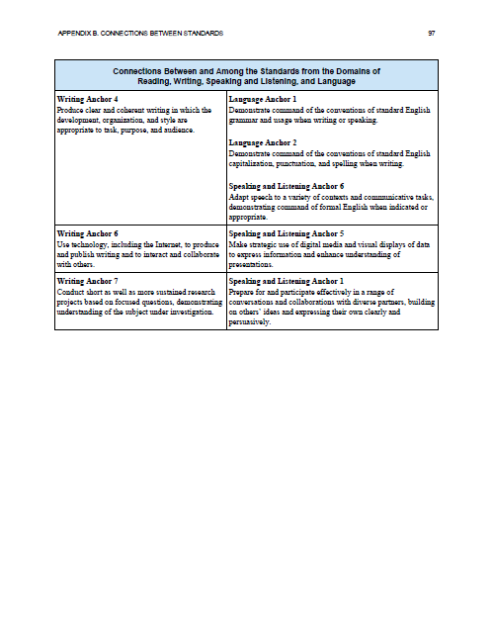
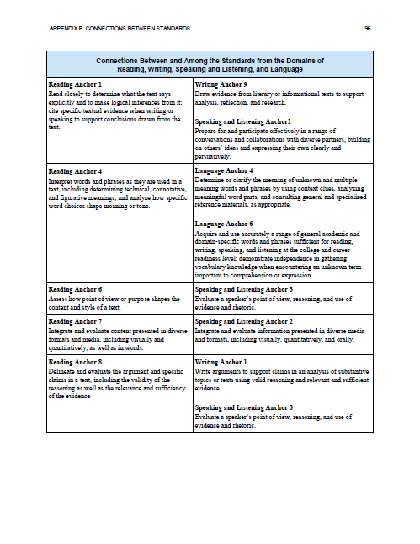
They Connect
ELA Standards
Reading
Writing
Speaking and Listening
Language
20
2018 The Institute for the Professional Development of Adult Educators
Notes:
Key Points
Reinforce that the standards throughout ELA connect across the different areas of reading, writing, speaking and listening, and language. For example, the reading anchor standard that incorporates reading closely connects to the writing standard of drawing evidence from texts to the speaking and listening standard of persuasive conversation about a specific topic. Then of course, there is the language standard of applying standard English conventions. It is indeed all connected!

Slide 21
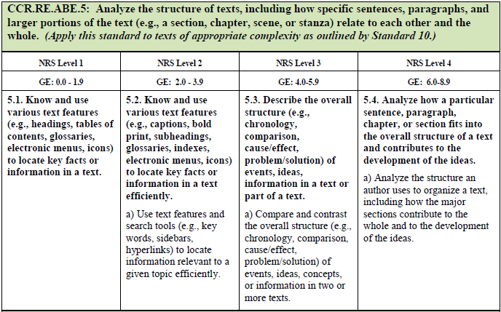
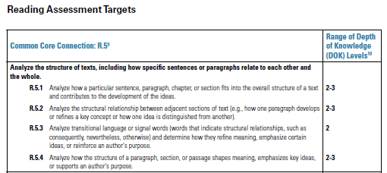
Consistency through Connection
CCRS for Adult Education
Florida GED® Preparation Curriculum Framework
(GED ® Assessment Targets)
Florida ABE Curriculum Framework
21
2018 The Institute for the Professional Development of Adult Educators
Notes:
Key Points
Show participants how (although the numbering system may differ) Florida’s ABE and GED® Preparation Curriculum Frameworks mirror the College and Career Readiness Standards for Adult Education. Also, refer participants to the GED Testing Service® alignment chart with the College and Career Readiness Standards. This provides participants with the connection piece that by implementing our standards, we are also heading towards total implementation of the federal initiative.
[Note that this slide has animation so that you can discuss how CCR Anchor Standard 5 is the same as Florida’s ABE standard 4, and is the same verbage as used in the GED Testing Service’s Assessment Targets and Florida’s GED® Preparation Curriculum Framework – Standard 4.

Slide 22
Decoding an ABE Standard
Source | Strand | Program Area | Anchor Standard | NRS (GE) Level Standard | Benchmark Skill
CCR | RE | ABE | 1 | 4 | a)
22
2018 The Institute for the Professional Development of Adult Educators
Notes:
Key Points
Show participants how an ELA standard in the Florida ABE Curriculum Framework is written. Discuss the different items for each standard. Reinforce how the anchor standard has a focus in each of the four levels of Adult Basic Education (as well as ASE/GED® Preparation).
Make sure that participants understand what the “letters” represent in the standard, e.g., GE, NRS, RE, etc. The next slides will delved more deeply into reading the standards.

Slide 23
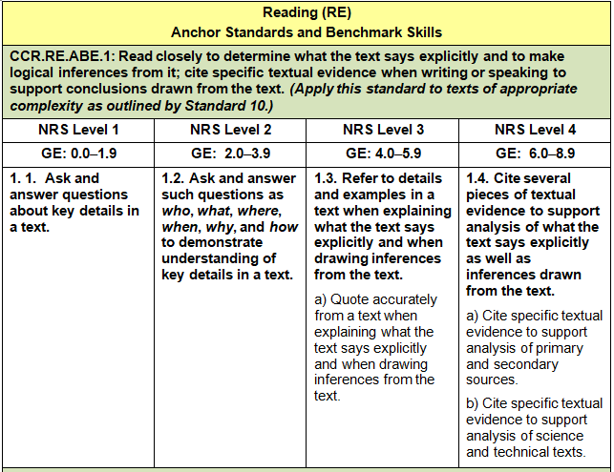
Exploring an ABE Reading Standard
Level
Anchor Standard
Focus of Standard
Level-Appropriate Expectations
23
2018 The Institute for the Professional Development of Adult Educators
Notes:
Key Points
Show participants how an ELA standard in the Florida ABE Curriculum Framework is written. Discuss the different items for each standard. Reinforce how the anchor standard has a focus in each of the four levels of Adult Basic Education (as well as ASE/GED® Preparation).
Make sure that participants understand what the “letters” represent in the standard, e.g., GE, NRS, RE, etc.

Slide 24
What does this mean for the ABE Classroom?
Close reading strategies are explicitly taught
Complex nonfiction and fiction text used
Reading skill levels increased
Ensure students use complex thinking skills in order to derive meaning from text
24
2018 The Institute for the Professional Development of Adult Educators
Notes:
Key Points
Discuss what this specific standard would mean for classroom instruction. A few ideas are listed on the slide. Have participants share the types of materials they currently see in their classrooms.
Reinforce that this includes:
Close reading strategies are explicitly taught
Nonfiction and fiction text used in classroom is more complex and rigorous
Reading skill levels must increase
Students are able to demonstrate more complex thinking in order to derive meaning from text (citing text, inferences, drawing conclusions, etc.)

Slide 25
Exploring an ABE Reading Standard
25
2018 The Institute for the Professional Development of Adult Educators
Notes:
Key Points
Show participants how an ELA standard in the Florida ABE Curriculum Framework is written. Discuss the different items for each standard. Reinforce how the anchor standard has a focus in each of the four levels of Adult Basic Education (as well as ASE/GED® Preparation).
Make sure that participants understand what the “letters” represent in the standard, e.g., GE, NRS, RE, etc.

Slide 26
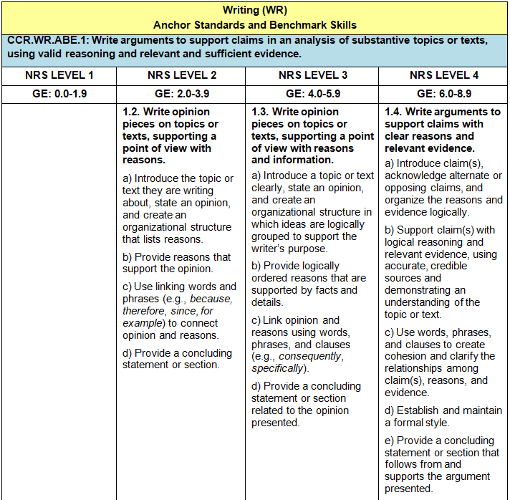
Exploring a Writing Standard
Workbook p. 3
26
2018 The Institute for the Professional Development of Adult Educators
Notes:
Key Points
Review a writing standard for the Florida ABE Curriculum Framework and discuss the different parts. Have participants identify the anchor standard, the levels, the focus of the standard, and the level-appropriate expectations.

Slide 27
Begin the Writing Process Early
At the Beginning Literacy Levels
Talk about a topic or text
Have students state their opinion
Have students provide reasons for that opinion
Discuss their reasons
Write a response based on the discussion
27
2018 The Institute for the Professional Development of Adult Educators
Notes:
Key Points
The next slides talk about skills that should be taught at the different levels regarding the writing process. Reinforce how the standards are developed on a continuum. Argumentative writing begins at NRS Level 2 and transitions in a step-by-step approach through ASE standards.

Slide 28
Build on Skills from Lower Levels
At Low Intermediate Levels
Have students read a text
Have students share their opinions
Have students provide reasons that are based on facts from the text
Discuss the validity of their reasons
Have students write a response that has basic organizational structure
28
2018 The Institute for the Professional Development of Adult Educators
Notes:
Key Points
These slides talk about skills that should be taught at the different levels regarding the writing process. Reinforce how the standards are developed on a continuum. Argumentative writing begins at NRS Level 2 and transitions in a step-by-step approach through ASE standards.

Slide 29
Build on Skills from Lower Levels
At High Intermediate Levels
Have students read a complex text in a specific content area (social studies, science)
Have students develop a claim
Have students identify evidence to support the claim
Discuss the validity of the evidence
Have students write a well-structure, logical response that supports their claim
29
2018 The Institute for the Professional Development of Adult Educators
Notes:
Key Points
These slides talk about skills that should be taught at the different levels regarding the writing process. Reinforce how the standards are developed on a continuum. Argumentative writing begins at NRS Level 2 and transitions in a step-by-step approach through ASE standards.

Slide 30
Argumentative Writing – It’s a Continuum
Beginning Literacy | Low Intermediate | High Intermediate
Talk about topic/text | Read text | Read text in specific content area
State opinions | Share opinions | Develop claim
Provide reasons for opinion | Provide reasons based on facts from text | Identify evidence to support claim
Discuss reasons | Discuss validity of their reasons | Discuss validity of evidence
Write a response based on discussion | Write a response that has organizational structure | Write a well-structured, logical response that supports claim
30
2018 The Institute for the Professional Development of Adult Educators
Notes:
Key Points
This information is also provided in chart format in the workbook.

Slide 31
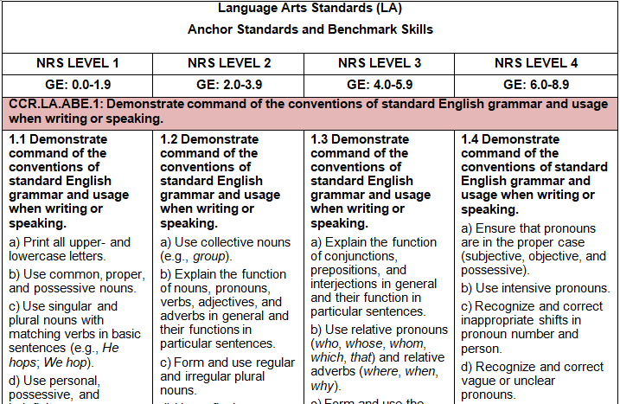
Exploring a Language Standard
What do you think?
Workbook p. 3
31
2018 The Institute for the Professional Development of Adult Educators
Notes:
Key Points
Discuss that in the ABE Curriculum Language Arts Curriculum Framework there are writing, speaking and listening, and language arts standards. Have participants look at the Language Arts Standards, Anchor Standard 1 and share their thoughts regarding the types of skills at each level – specifically the lower ABE levels.
Possible questions for discussion:
As you reviewed the anchor standard regarding demonstrating command of the conventions of standard English grammar and usage when writing or speaking, did you have any surprises? Any concerns?
Is there a continuum to teaching these skills?
Are your programs teaching grammar and usage through a contextualized approach?
Are your materials teaching these skills at the appropriate levels?
Are some of these skills taught in your GED® Preparation programs? Is this an appropriate place for teaching these skills? Why or why not?

Slide 32
Teach Grammar from Context
Look beyond the workbooks and worksheets
Move away from teaching grammar in isolation
Help students understand how they will use what they learn with what they do in the real-world of work, home, and community
Identify materials that more clearly connect basic skills with their application
Help students recognize that they can be effective writers
32
2018 The Institute for the Professional Development of Adult Educators
Notes:
Key Points
Discuss what this specific standard would mean for classroom instruction and our programs. A few ideas are listed on the slide. Have participants share the types of materials they currently see in their classrooms.

Slide 33
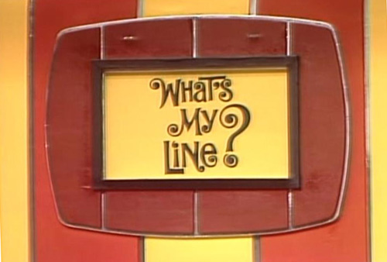
What’s My Standard?
33
2018 The Institute for the Professional Development of Adult Educators
Notes:
Key Points
Have group play “What’s My Standard?” – a take off on What’s My Line? The activity is located in your resources and is linked to this slide.

Slide 34
“…if standards are not taught in a clear and well defined manner, it is unlikely that students will attain them.”
2018 The Institute for the Professional Development of Adult Educators
Notes:
Key Points
The quote reinforces the need for us to deeply understand the standards before we implement them in our programs. Discuss strategies for assisting staff at each site to better understand the standards and first steps in development of curricula.

Slide 35
Professional Development Needs
Standards
Assets
Abilities
Associations
Workbook p. 4
35
2018 The Institute for the Professional Development of Adult Educators
Notes:
Key Points
Refer to page 4 in the workbook on how to analyze professional development using the standards to connection to teaching (associations) to the resources (assets) to the content training and methods training (abilities). This should underline how instructors should reflect on professional development necessary to successfully implement standards in the classroom.

Slide 36
Remember . . .
The standards are written; you do not need to develop them.
You need to sort through standards and identify those consistent with your program’s objects and your student’s needs.
You need to establish a system to implement a standards-based instructional program that is “realistic in terms of your program’s characteristics.
You need to keep the trends and background in mind. Don’t get lost in the forest of details.
36
2018 The Institute for the Professional Development of Adult Educators
Notes:
Key Points
Review the overview.

Slide 37
What the CCRS for AE are Not!
They are not
an order in which standards are to be taught.
directions about how instructors should teach.
a full spectrum of support and interventions for students.
a curriculum, so programs will need to complement them with a certain type of high-quality curricula.
a national or federal set of mandates.
37
2018 The Institute for the Professional Development of Adult Educators
Notes:
Key Points
Reinforce what the standards are not and why it is important as an instructional leader to support the development of a strong curriculum in their programs.

Slide 38
The Missing Piece
Standards are not a curriculum
Standards are statements about WHAT students should know/be able to do.
Instructors decide HOW students should get there.
2018 The Institute for the Professional Development of Adult Educators
Notes:
Key Points
Review slide.

Slide 39
Think About It!
What does this mean for our ABE classrooms?
39
2018 The Institute for the Professional Development of Adult Educators
Notes:
Key Points
Have participants share what they think a standards-based education means to their classroom.

Slide 40
ELA/Literacy Shifts
Practice with Key Shifts
40
2018 The Institute for the Professional Development of Adult Educators
Notes:
Key Points
Now that we have reviewed how standards are written, lets spend some time on the key shifts in ELA/Literacy.

Slide 41
Key Shifts in ELA Standards
Workbook p. 5
Shift 1: Complexity
Regular practice with complex text and its academic language
Shift 2: Evidence
Reading, writing, and speaking grounded in evidence from text, both literary and informational
Shift 3: Knowledge
Building knowledge through content-rich nonfiction
41
2018 The Institute for the Professional Development of Adult Educators
Notes:
Key Points
So, what is so different about the ELA standards? It’s the shifts or key shifts that occur across each of the standards throughout all levels.
Review the three key shifts in the college and career ready English Language Arts/Literacy standards. Additional information on each of the key shifts is included on the next four slides. Reiterate that these same shifts occur in the assessment targets for the 2014 GED® test, as in Florida’s ABE curriculum frameworks.
For more information on each of the shifts listed above, review Chapter 4 of the College and Career Readiness Standards for Adult Education prepared for the U.S. Department of Education, Office of Vocational and Adult Education, 2013.

Slide 42
Complexity
Shift 1 – Complexity: Regular practice with complex text and its academic language
Complexity of text that students can read is the greatest predictor of success
Gap between complexity of college and high school texts is huge (four grade levels)
Too many students are reading at too low a level (less than 50% of graduates can read sufficiently complex texts)
Focus needed on addressing academic vocabulary of students
42
2018 The Institute for the Professional Development of Adult Educators
Notes:
Key Points
Review the information provided in each of the bullet points. Emphasize the need for instructors to embrace the need for students to increase their reading skills and be able to read and understand complex texts. Instructors must be aware that instruction and instructional materials should provide students with text complex enough to be challenging.
Additional information is included in Appendix D, Special Topic – Understanding Text Complexity. This information was provided by the National Governors Association Center for Best Practices, Council of Chief State School Officers. 2002.
For more information on each of the shifts listed above, review Chapter 4 of the College and Career Readiness Standards for Adult Education prepared for the U.S. Department of Education, Office of Vocational and Adult Education, 2013.

Slide 43
Implications for Instruction
Standards have raised the bar for what students should read and understand at each level.
Passages should be of high quality so that they are worthy of close reading.
Text complexity and text quality share powerful links:
Only by reading a complex text is one able to increase reading proficiency.
CCR-aligned questions cannot be asked of passages lacking complexity and fully developed ideas.
43
2018 The Institute for the Professional Development of Adult Educators
Notes:
Key Points
Review the ideas on the slide regarding implications for instruction.
Emphasize the need for instructors to “raise the bar” regarding the selection of text to use in the classroom as they look at implementing college and career readiness standards. Raising the bar is important in adult education, whether you’re in professional development – where you need to raise the bar – or if you are a program manager/administrator – where you need to raise the bar for your programs.

Slide 44
Time to Brainstorm
Workbook p. 6
What is complex text?
44
Notes:
Key Points
Have participants brainstorm a definition for complex text. Capture their ideas on chart paper.
Use the following slides to support the ideas from the group. See if there are additional/missed ideas.

Slide 45
What makes text Complex ?
Complex sentences
Uncommon vocabulary
Lack of words, sentences or paragraphs that review or pull things together for the student
Lengthy paragraphs
Text structure that is less narrative and/or mixes structures
45
2018 The Institute for the Professional Development of Adult Educators
Notes:
Key Points
Use the following slides to support the ideas from the group. See if there are additional/missed ideas.

Slide 46
What makes text Complex ? (cont.)
Subtle and/or frequent transitions
Multiple and/or subtle themes and purposes
Dense information
Unfamiliar settings, topics or events
Lack of repetition, overlap, or similarity in words and sentences
46
2018 The Institute for the Professional Development of Adult Educators
Notes:
Key Points
Use the slides to support the ideas from the group. See if there are additional/missed ideas.

Slide 47
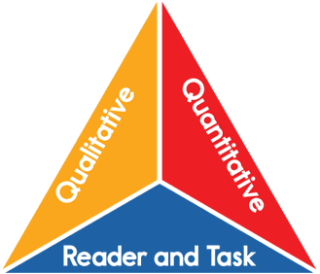
Shift 1: Text Complexity
Text features best judged by human evaluation.
Text structure, vocabulary, knowledge demands
What a computer can see and measure.
Word, sentence, text length/familiarity
What an instructor or student does with the text.
Motivation, prior knowledge & experience, lesson task
47
2018 The Institute for the Professional Development of Adult Educators
Notes:
Key Points
Let’s look at it a different way.

Slide 48
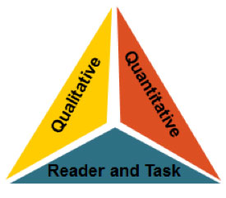
Three Part System for Measuring Text
What Do These Parts Mean and How Do They Work Together?
Quantitative Scale: What a computer can “see” and measure
Qualitative Measures: Text features best judged by human evaluation (structure, language and knowledge demands, and purpose)
Professional Judgment: What the instructor does with this text to help students read and understand it
48
2018 The Institute for the Professional Development of Adult Educators
Notes:
Key Points
Review the different features of text complexity. Discuss how this impacts what materials are currently being used in the adult education classroom.
Quantitative (scale or readability formulas)
Word length
Word frequency/familiarity
Sentence length and text length
Qualitative measures
Purpose(s)
Text structures
Language features
Knowledge demands
Professional Judgment (of reader and task)

Slide 49
Quantitative Scale
CCRS Levels of Learning | ATOS | Degrees of Reading Power | Flesch-Kincaid | The Lexile Framework | Reading Maturity | SourceRater
B (2^{.0} – 3rd) | 2.75 – 5.14 | 42 – 54 | 1.98 – 5.34 | 420 – 820 | 3.53 – 6.13 | 0.05 – 2.48
C (4th – 5th) | 4.97 – 7.03 | 52 – 60 | 4.51 – 7.73 | 740 – 1010 | 5.42 – 7.92 | 0.84 – 5.75
D (6th – 8th) | 7.00 – 9.98 | 57 – 67 | 6.51 – 10.34 | 925 – 1185 | 7.04 – 9.57 | 4.11 – 10.66
E (9th – 10th) | 9.67 – 12.01 | 62 – 72 | 8.32 – 12.12 | 1050 – 1335 | 8.41 – 10.81 | 9.02 – 13.93
E (11th – CCR) | 11.20 – 14.10 | 67 – 74 | 10.34 – 14.2 | 1185 – 1385 | 9.57 – 12.00 | 12.30 – 14.50
49
2018 The Institute for the Professional Development of Adult Educators
Notes:
Key Points
Review the chart and the different ways to determine a quantitative scale.

Slide 50
Qualitative Measures
Category | Notes and comments on text, support for placement in this band | Where to place within the level?
 |  | Beginning of Level | Middle of Level | Top of Level | NOT Suited to Level
Structure
Language Clarity and Conventions
Knowledge Demands
Purpose
Overall Placement
50
2018 The Institute for the Professional Development of Adult Educators
Notes:
Key Points
Review the chart and the different facets of text complexity using qualitative measures. Instructional leaders may wish to include this type of chart in professional development trainings so that instructors can discuss how to determine appropriate text for lessons.

Slide 51
Professional Judgment
“Students who struggle greatly to read texts within (or even below) their text complexity [level] must be given the support needed to enable them to read at an appropriate level of complexity. Even many students on course for college and career readiness are likely to need scaffolding as they master higher levels of text complexity.”
(From Appendix A, p.9, CCSS – ELA)
51
2018 The Institute for the Professional Development of Adult Educators
Notes:
Key Points
Discuss the rationale for professional judgment when selecting appropriate texts.

Slide 52
Determining Text Complexity
General Rule: Use the quantitative measures to place a text within a band, and qualitative measures to place the text at the top, middle, or bottom of the band.
http://www.ccsso.org/topics/navigating-text-complexity-resources
52
2018 The Institute for the Professional Development of Adult Educators
Notes:
Key Points
Reinforce that quantitative and qualitative measures are at once useful and imperfect:

Slide 53
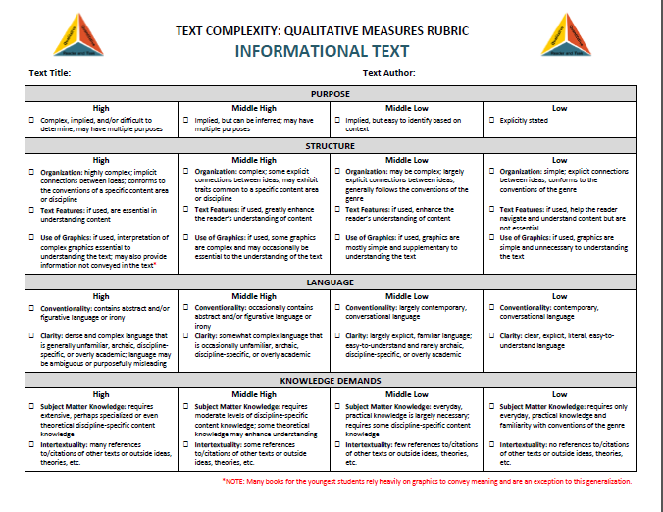
Text Complexity Rubric
Handouts
53
2018 The Institute for the Professional Development of Adult Educators
Notes:
Key Points
Review the different features of text complexity. Discuss how this impacts what materials are currently being used in the adult education classroom.
There are two handouts on text complexity in the participants’ materials.

Slide 54
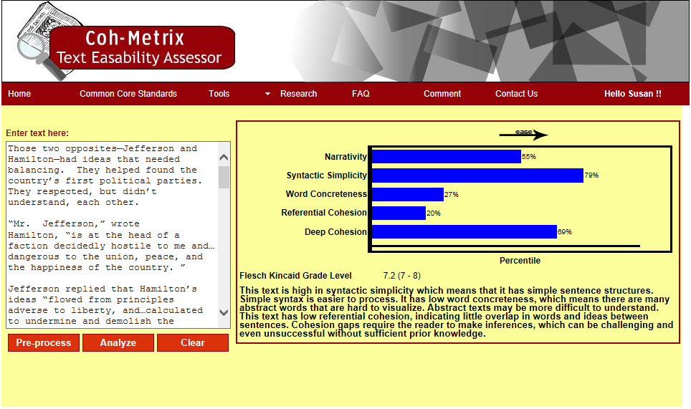
Tools for the Classroom
Workbook pp. 7 & 8
http://cohmetrix.com/
History of US – The Parties Begin
54
2018 The Institute for the Professional Development of Adult Educators
Notes:
Key Points
Have participants take out the workbook and read pages 5 & 6. Provide them with approximately 3 minutes. Ask them if the text as complex. Why or why not. Discuss that there are many different types of tools that can be used by instructors to determine text complexity. One of them is the Coh-Metrix Text Easability Assessor developed by the Universityhttp://cohmetrix.com/ of Memphis. Show participants the information provided through this tool. These two slides provide a screen capture of the analysis, as well as additional information for instructional purposes, e.g., vocabulary, different readability formulas, etc.
The following is information regarding each of the measures of the Coh-Metrix tool.
Narrative text tells a story, is closely connected with everyday, oral conversation, is highly affiliated with words that are familiar, real-life knowledge, and oral language. Non-narrative on less familiar topics lie at the opposite end of the continuum.
Syntactic Simplicity refers to the degree to which sentences in the text contain fewer words, use simpler, familiar structure, and are less challenging to process. At the other end of spectrum are texts with longer, more complex and less familiar syntactic structure.
Text that contain content words that are concrete, meaningful, and evoke mental images are easier to process and understand. Abstract words represent concepts that are difficult to represent visually. Texts with more abstract words are more challenging to understand.
Referential Cohesion refers to text that contains words and ideas that overlap across sentences, paragraphs, and the entire text, forming explicit threads that connect the text for the reader. Lower cohesion text is typically more difficult to process because there are fewer connections that tie the ideas together for the reader.
Deep Cohesion refers to the degree to which the text contains causal and intentional connectives within the text. These connectives help the reader to form a more coherent and deeper understanding the events, processes, and actions in the text. Without the connectives, the reader must infer the relationships between the ideas in the text. If the text is high in deep cohesion, the relationships and global cohesion are more explicit.

Slide 55
Time to Read and Assess
Workbook pp. 9 - 13
Determining text
complexity
55
Notes:
Key Points
There are different reading excerpts in the guide. Have participants read some or all of them. Make sure that you have participants read excerpts of differing levels.
Have participants read the excerpts and answer the following questions:
Which text is most complex?
Which text has the highest readability level?
Which text has the lowest readability level?
Which text(s) would present the greatest challenge for your students? Why?
Excerpts included in the guide (with the Coh-Metrix Text Easability Assessor documentation) are:
So You Want to Be President – 5.9 Flesch Kincaid Grade Level.
Untangling the Roots of Cancer – 9.4 Flesch Kincaid Grade Level.
Wind Power – 1.0 Flesch Kincaid Grade Level.
The History of US – 4.9 Flesch Kincaid Grade Level.
Letters from the Birmingham Jail – 11.3 Flesch Kincaid Grade Level.
Space Probe – 7.0 Flesch Kincaid Grade Level.

Slide 56
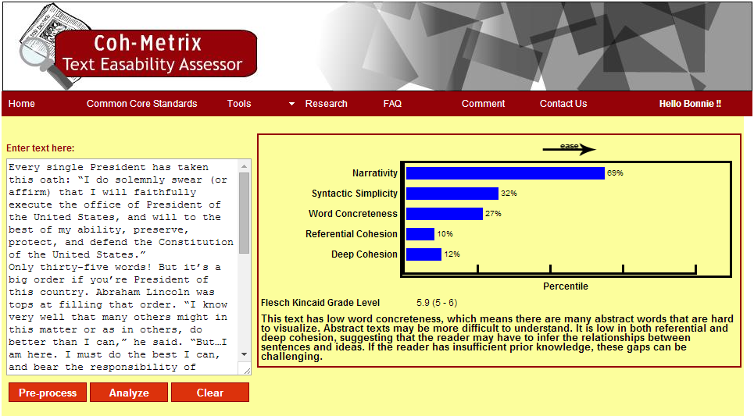
Text Complexity
St. George, Judith. So You Want to Be President?
56
2018 The Institute for the Professional Development of Adult Educators
Notes:
Key Points
Excerpt from: St. George, Judith. “So You Want to Be President?” Discuss the different areas of complexity in this text at the 5.9 Flesch Kincaid Grade Level.

Slide 57
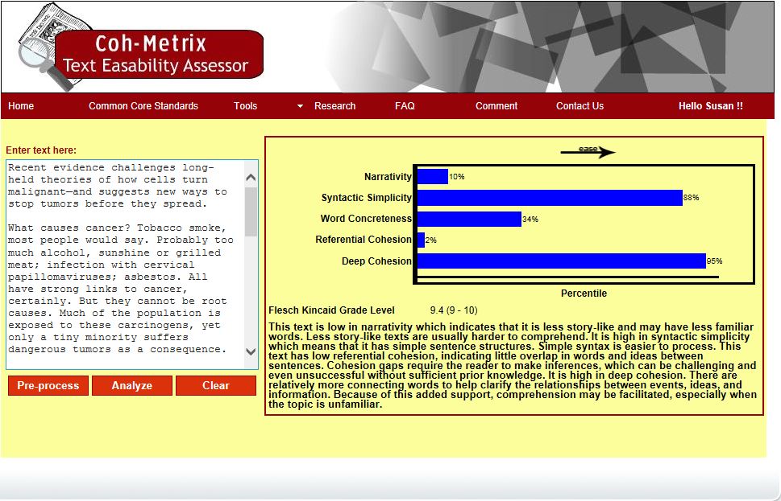
Text Complexity
Gibbs, W. Wayt. Untangling the Roots of Cancer.
57
2018 The Institute for the Professional Development of Adult Educators
Notes:
Key Points
Excerpt from: Gibbs, W. Wayt. “Untangling the Roots of Cancer.” Scientific American Special Edition June 2008. Discuss the different areas of complexity in this text at the 9.4 Flesch Kincaid Grade Level.

Slide 58
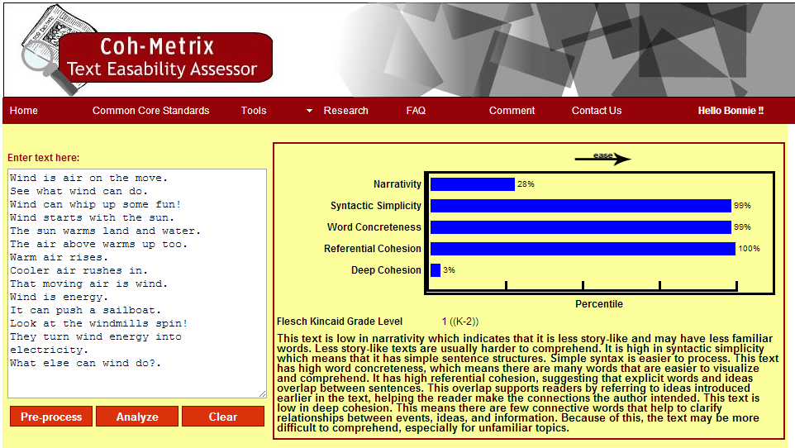
Text Complexity
Wind Power from National Geographic
58
2018 The Institute for the Professional Development of Adult Educators
Notes:
Key Points
Excerpt from: “Wind Power.” National Geographic Young Explorers November/December 2009. (2009).
Discuss the different areas of complexity in this short nonfiction writing at the 1.0 Flesch Kincaid Grade Level.

Slide 59
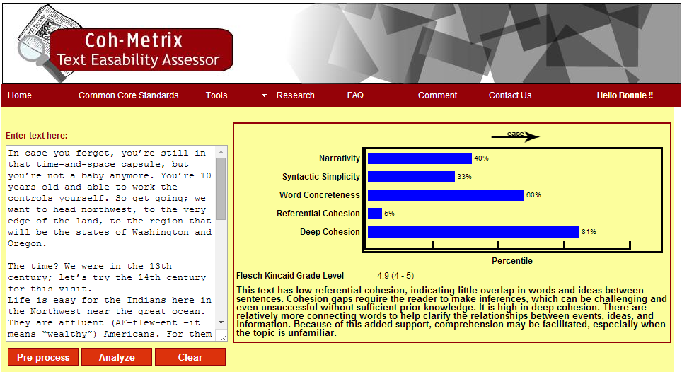
Text Complexity
Hakim, Joy. A History of US. “The Show-Offs”
59
2018 The Institute for the Professional Development of Adult Educators
Notes:
Key Points
Excerpt from: “Hakim, Joy. A History of US. Oxford: Oxford University Press, 2005. (2005). From Book 1: The First Americans, Prehistory to 1600; Chapter 7: “The Show-Offs.”
Discuss the different areas of complexity in this short nonfiction writing at the 4.9 Flesch Kincaid Grade Level.

Slide 60
Text Complexity
King, Dr. M. L. Letters from Birmingham Jail
60
2018 The Institute for the Professional Development of Adult Educators
Notes:
Key Points
Excerpt from: “Letters from the Birmingham Jail” by Dr. King.
Discuss the different areas of complexity in this historical nonfiction piece at the 11.3 Flesch Kincaid Grade Level.

Slide 61
Text Complexity
“Space Probe.” Astronomy & Space: From the Big Bang to the Big Crunch.
61
2018 The Institute for the Professional Development of Adult Educators
Notes:
Key Points
Excerpt from: “Space Probe.”
Discuss the different areas of complexity in this science nonfiction piece at 7.0 Flesch Kincaid Grade Level.

Slide 62
Implications for Instruction
Workbook p. 14
Why is text complexity
so essential?
62
Notes:
Key Points
Have participants discuss the implications for instruction when using complex, nonfiction text in the ABE/ASE classroom. This slide provides some ideas that participants should have identified in their brainstorming the need for complex text.
Review the ideas from the group and include those that were not identified.
Some ideas of why text complexity is so essential are:
Academic vocabulary can only be learned from complex texts.
Mature language skills needed for success can only be gained by working with demanding materials.
Students won’t be prepared for postsecondary education/workplace because reading simplified texts that have restricted, limited, and/or thin meaning.
There is no evidence that struggling readers catch up by gradually increasing the complexity of simpler texts.

Slide 63
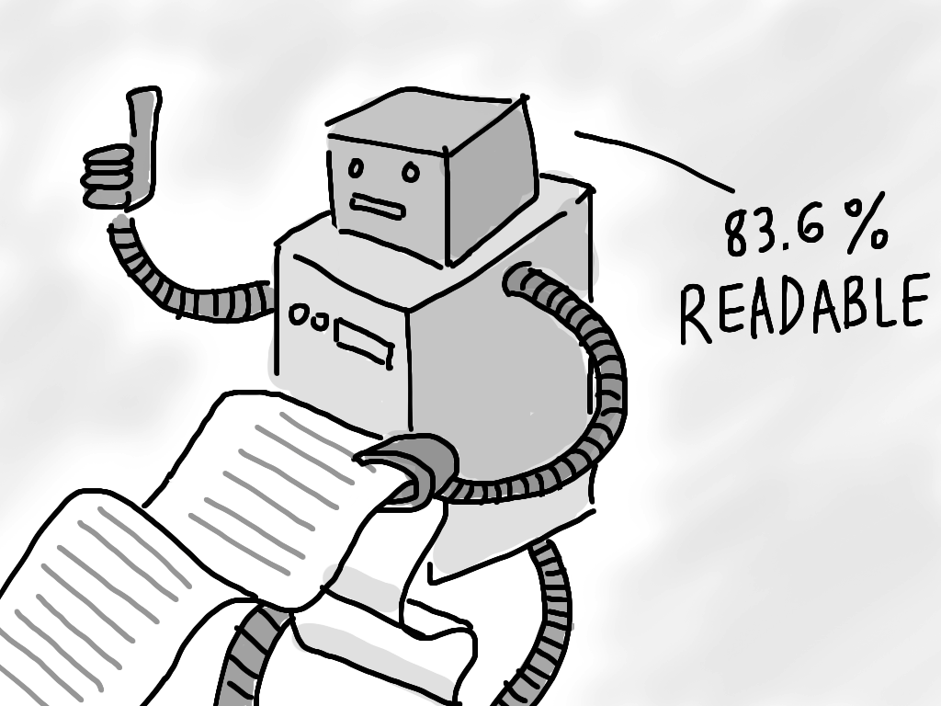
Online Readability Tools
Workbook p. 15
63
2018 The Institute for the Professional Development of Adult Educators
Notes:
Key Points
Everyone loved the Coh-Metrix text assessor at the training, so we thought we’d find some additional readability tools for your use. Share the tools from pages 1 and 2.

Slide 64
Evidence
Shift 2 – Evidence: Reading, writing, and speaking grounded in evidence from text, both literary and informational
Priority placed on textual evidence based on national assessment data
Focus is on students’ ability to cite evidence from text in order to present
Careful analyses
Well-defended claims
Clear information
64
2018 The Institute for the Professional Development of Adult Educators
Notes:
Key Points
Review the information provided on textual evidence. Emphasize the importance of students being able to read, write and speak based on the evidence they have gleaned from literary and informational text. Discuss the need to explore what programs are currently doing and what they will need to do in in order to move students beyond basic reading comprehension skills to higher critical reading skills.

Slide 65
Text-Dependent Questions
Text-Dependent Questions
Are questions that can only be answered correctly by close reading of the text and demand careful attention to the text
Require an understanding that extends beyond recalling facts
Often require students to infer
Allow students to gather evidence and build knowledge
Provide access to increasing levels of complex text
65
2018 The Institute for the Professional Development of Adult Educators
Notes:
Key Points
The next major shift for our programs is to implement text-dependent questions. Review this slide.
Define what a text dependent question is from this slide. A text specific question can only be answered by the unique text that is being read.
Discuss the fact that TDQs are major forms of support for students. They point to the parts of the text that matter most for:
Building solid understanding
Understanding the central ideas of the text and fulfilling the learning purpose for which the author planned.

Slide 66
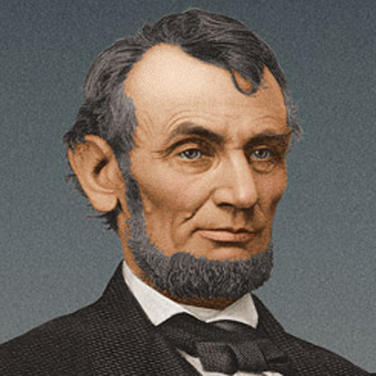
Evidence
Answering Text-Dependent Questions
Have you ever been to a funeral? Compare your experience to that at Gettysburg.
Lincoln says that the nation is dedicated to the proposition that “all men are created equal.” Why is equality an important value to promote?
Would you need to read the Gettysburg Address to answer these questions?
66
2018 The Institute for the Professional Development of Adult Educators
Notes:
Key Points
Begin the discussion on text-dependent questions by referring to the Gettysburg Address. Ask whether or not a student would need to have read the excerpt in order to answer the questions.

Slide 67
Evidence
Answering Text-Dependent Questions
Did Lincoln think that the North was going to “pass the test” that the civil war posed?
Why did Lincoln give this speech? Why does Lincoln shift the focus of his speech from what he says is the purpose at the end of the second paragraph?
Explain the logical progression of Lincoln’s argument.
How about these questions?
67
2018 The Institute for the Professional Development of Adult Educators
Notes:
Key Points
Review these questions and have participants identify whether or not these are text-dependent questions.

Slide 68
Progression of Text-Dependent Questions
Workbook p. 18
Whole
Opinions, Arguments, Inter-textual Connections
Inferences
Author’s Purpose
Vocabulary & Txt Structures
Key Details
General Understanding
Across texts
Entire texts
Segments
Paragraph
Sentence
Word
Part
68
2018 The Institute for the Professional Development of Adult Educators
Notes:
Key Points
Source: Frey, N. & Fisher, D. Common core language arts in a PLC at work. Bloomington, IN: Solution Tree.
Discuss that there are various levels of text-dependent questions, from those that require a general understanding up to being able to make inferences and intertextual connections. Text-dependent questions can be developed based on a single word in a text to an entire text or across texts. The complexity of a text-dependent question or group of questions is dependent on the level of learning and the complexity of the text used.
Share that a larger graphic is on page of the workbook.

Slide 69
Question Types
Type I: Find it (Most literal – requires reader to find explicitly stated facts and details in text.)
Type II: Look Closer (Literal, but requires searching in more than one place.
Type III: Prove It (Inferential/critical thinking/problem solving – readers search for clues/evidence to support their answers.)
69
2018 The Institute for the Professional Development of Adult Educators
Notes:
Key Points
Dependent on the group, you may wish to provide participants with a brief overview of different types of text-based questions.
Type I: Find it (Most literal – requires reader to find explicitly stated facts and details in text.)
Identify facts and details.
What is . . . ?
Where is . . . ?
Who is . . . ?
Type II: Look Closer (Literal, but requires searching in more than one place.
Demonstrate understanding of information found in more than one place.
Compare and contrast
Explain
Summarize
What do the facts or ideas show?
How would you rephrase the meaning?
Type III: Prove It (inferential/critical thinking/problem solving – readers search for clues/evidence to support their answers.)
Analyzing or evaluating the information.
Identify the main idea
Draw conclusions
Make predictions
Make inferences
What is the theme?
How would you?
QAR – Questioning the Author – right there, think and search, author and you, on my own

Slide 70
Developing a Strong Question Set
Workbook pp. 18 - 21
Investigate qualitative features
Identify key ideas
Start small
Target vocabulary and text/sentence structure
Tackle tough sections head-on
Create coherent sequences
Identify the standards that are being addressed
Create a culminating assessment
70
2018 The Institute for the Professional Development of Adult Educators
Notes:
Key Points
Review how to develop a text-dependent question and a strong question set. You may wish to have participants review the chart – “Text Dependent Question Types: Informational Text” prior to completing the activity. May wish to have participants use handout to determine if it is a 1, 2, 3 type of question.
Ideas to reinforce include:
Investigate qualitative features
Identify key ideas from the text
Start small to build confidence and check understanding
Target vocabulary and text/sentence structure
Tackle tough sections head-on
Create coherent sequences of text-dependent questions
Identify the standards that are being addressed
Create a culminating assessment by referring back to the core understanding or key ideas

Slide 71
Developing Text-Dependent Questions
Workbook pp. 9, 10, 21
Developing Text
Dependent Questions
71
Notes:
Key Points
Have participants read and develop text-dependent questions. Have them share questions and debrief how these questions are similar or dissimilar to what is currently being used in the adult education classroom.
Directions are as follows:
Review the excerpt from “Untangling the Roots of Cancer”, pages 9 and 10
In your groups, develop two text-dependent questions for that text.
Be prepared to share your questions with the rest of the group.
Refer participants to the workbook for additional information on developing text-dependent questions. Highlight the basic information, “typical text dependent questions . . . . and talk about bulleted items.
You may wish to have participants evaluate their questions using the Checklist for Evaluating Questions Quality in the workbook.

Slide 72
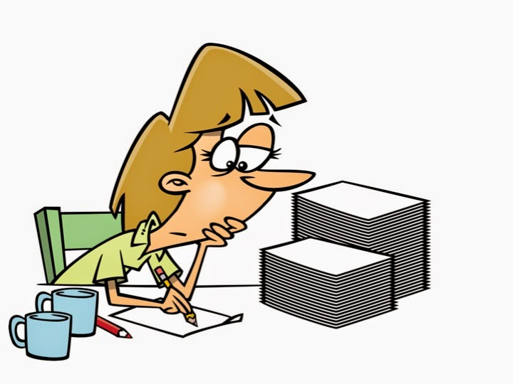
Delving Deeper – Sentence Frames
Workbook pp. 25-30
Use sentence frames to get started writing text-based questions (by standard)
72
2018 The Institute for the Professional Development of Adult Educators
Notes:
Key Points
We spent a short time writing text-dependent questions when we worked together. However, there is much more to writing these types of questions than just stating, according to the passage or the author. To assist you in developing text-dependent questions, you may wish to use sentence frames/starters on pages 25-30. These are organized by reading standard.

Slide 73
Shift 3: Content-Rich Nonfiction
Shift 3 – Knowledge: Building knowledge through content-rich nonfiction
Focus shifts to nonfiction text that constitutes the majority of what people read in college and the workplace
Focus shifts to teaching knowledge while teaching reading skills
73
2018 The Institute for the Professional Development of Adult Educators
Notes:
Key Points
Discuss how students build knowledge through reading and writing. Emphasize the importance of having students read and write about more than just literary works. Discuss the need to include a wide range of nonfiction texts that reflect what students will be expected to interact with in real-life situations, at home, in the workplace, and in higher education and training.

Slide 74
Implications for Instruction
Focus on content-rich informational texts—texts worth reading and rereading—in curriculum.
Provide coherent selections of strategically sequenced texts so that students can build knowledge about a topic.
Gear writing toward informational, procedural or argumentative tasks rather than personal narration.
Always demand evidence in student writing.
Include conducting short research projects to answer a question, drawing on several sources.
74
2018 The Institute for the Professional Development of Adult Educators
Notes:
Key Points
Review the bullet points on the implications of how using content-rich nonfiction is useful in the classroom.
Focus on content-rich informational texts—texts worth reading and rereading—in curriculum.
Provide coherent selections of strategically sequenced texts so that students can build knowledge about a topic.
Gear writing toward informational, procedural or argumentative tasks rather than personal narration.
Always demand evidence in student writing.
Include conducting short research projects to answer a question, drawing on several sources.

Slide 75
Content-Rich Nonfiction
Workbook pp. 31 - 33
Building Your Instructional Library
Websites for fiction & nonfiction articles
75
2018 The Institute for the Professional Development of Adult Educators
Notes:
Key Points
Everyone love the Newsela website and all of things that it was able to do. Remember, to get the maximum from the site, you need to register first.
However, there were many requests for additional sites from the World Wide Web where instructors could obtain free fiction and nonfiction materials that would be usable in the adult education classroom. It’s hard to come up with just a couple, so let’s look at more sites, all free, that you can share with your instructors.

Slide 76
Implications for Instruction
Workbook p. 31
Processing the Shifts
76
Notes:
Key Points
This discussion is designed to provide participants with an opportunity to reflect upon each of the key shifts that have been discussed and their implications for classroom practice in their programs. It is meant to be a summative activity.
Approximate Time: This discussion requires approximately 20 – 30 minutes.
Materials:
Description of the ELA/Literacy Shifts
Processing the Shifts
Directions:
Read the Description of the ELA/Literacy Shifts handout.
Allow 10 – 15 minutes of independent work time for participants to consider what each shift means, and the perceived challenges and opportunities presented by each shift to their programs. Participants should also incorporate ideas from the presentation materials on the three shifts.
Participants are to record their thoughts on the Processing the Shifts handout.
The facilitator will lead a discussion to share and record collective opportunities and challenges presented by the shifts. The discussion can be conducted in large group or small group settings.

Slide 77
Putting It All Together
Remember, Three Shifts in CCRS ELA/Literacy Boil Down to . . .
Texts worth reading!
Questions worth answering!
Work worth doing!
77
2018 The Institute for the Professional Development of Adult Educators
Notes:
Key Points
Remember, when looking at implementing the new ABE standards for ELA, it all comes down to texts worth reading, questions worth answering, and work worth doing.

Slide 78
They Connect
ELA Standards
Reading
Writing
Speaking and Listening
Language
78
2018 The Institute for the Professional Development of Adult Educators
Notes:
Key Points
After debriefing the activity, complete the final few slides as a summarization of the three major shifts.
Reinforce that the standards throughout ELA connect across the different areas of reading, writing, speaking and listening, and language. For example, the reading anchor standard that incorporates reading closely connects to the writing standard of drawing evidence from texts to the speaking and listening standard of persuasive conversation about a specific topic. Then of course, there is the language standard of applying standard English conventions. It is indeed all connected!

Slide 79
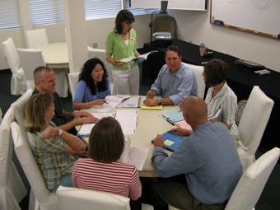
Reflections: Whole Group Sharing
79
2018 The Institute for the Professional Development of Adult Educators
Notes:
Key Points
Provide the opportunity for each participant to reflect and/or share one comment on the workshop and the movement towards standards-based education.

Slide 80
Looking for more resources?
floridaipdae.org
80
2018 The Institute for the Professional Development of Adult Educators
Notes:
Key Points
Animations to point out where to find more resources. Include the additional resources included in the training.

Slide 81
Remember, as Instructional Leaders
Always remember that . . .
81
2018 The Institute for the Professional Development of Adult Educators
Notes:
Key Points
Reinforce that implementing a standards-based education is one that is always under construction!

Slide 82
82
2018 The Institute for the Professional Development of Adult Educators

Slide 83
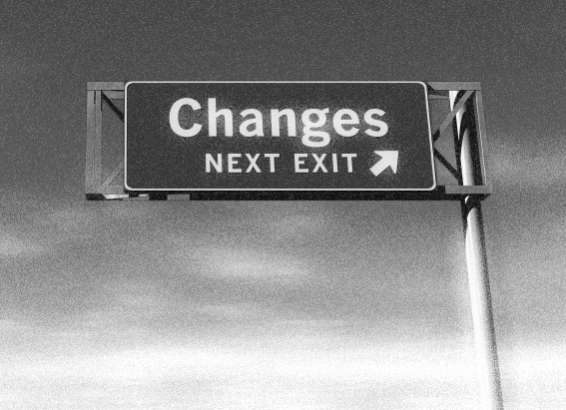
www.floridaipdae.org
“The best professional development is ongoing, experiential, collaborative, and connected to and derived from working with students.”
Edutopia 2014
Always here to assist!
The IPDAE Team
83
2018 The Institute for the Professional Development of Adult Educators

